Slide 1

Image Denoising using Decomposition methods: Comparative Analysis
SIGNAL AND IMAGE PROCESSING

Slide 2
TEAM 7
NAME | ROLL NUMBER
DINESH KUMAR M. R. | CB.EN.U4AIE20011
JANGALA GOUTHAMI | CB.EN.U4AIE20023
K. S. PAVAL | CB.EN.U4AIE20047
SHREYA SANGHAMITRA | CB.EN.U4AIE20066
N. T. SHRISH SURYA | CB.EN.U4AIE20067

Slide 3
Decomposition Methods used:
Singular Value Decomposition (SVD)
Discrete Cosine Transform (DCT)
Wavelet Transform
Non-Negative Matrix Factorisation (NMF)
Principle Component Analysis (PCA)

Slide 4
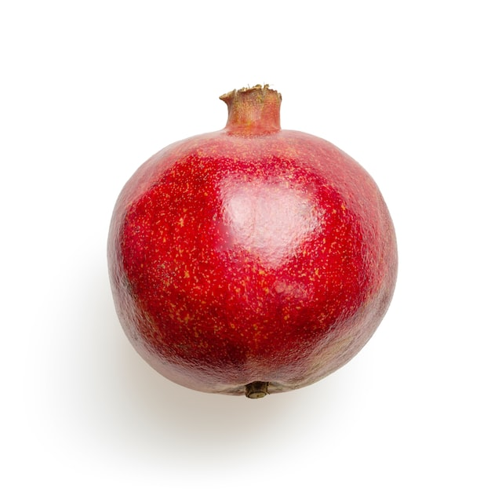
Image used

Slide 5
3 Different types of noise in 5 levels (10%, 20%, 30%, 40%, 50%)
Gaussian Noise
Salt & Pepper
Speckle

Slide 6
Singular Value Decomposition (SVD) Denoising
SVD is used to decompose an image into three matrices: the left singular matrix, the right singular matrix, and the diagonal matrix of singular values :
(where A is the image matrix )​

Slide 7
To denoise the image:
(Σ' is the truncated version of the Σ matrix after applying threshold)
The thresholding step( where the threshold is t) is used to suppress singular values that are likely to be due to noise, while preserving those that are likely to be part of the underlying signal and so the truncated S' is calculated as:

Slide 8
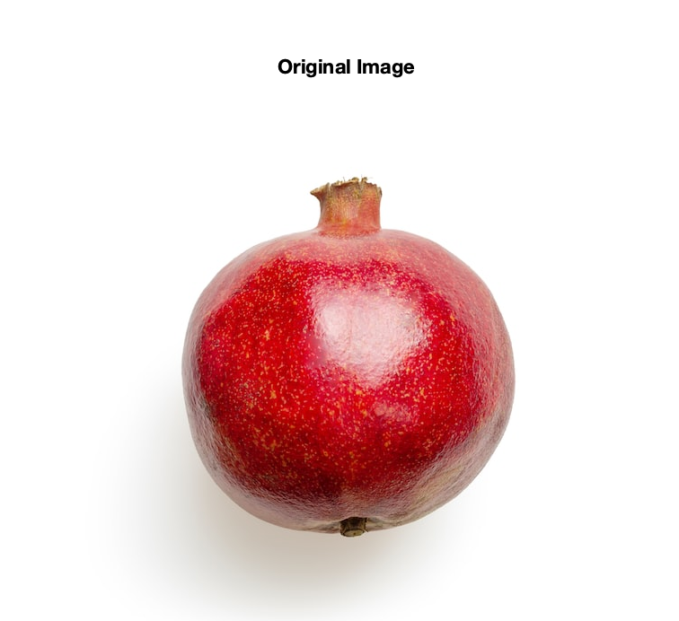
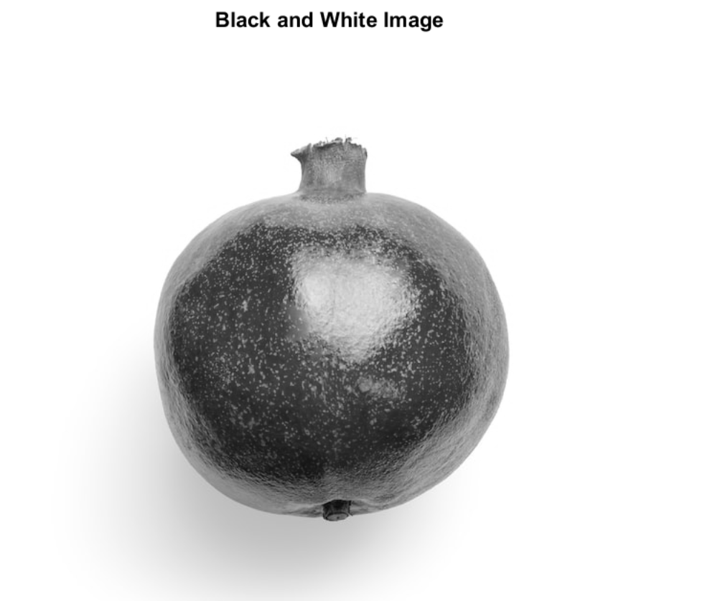
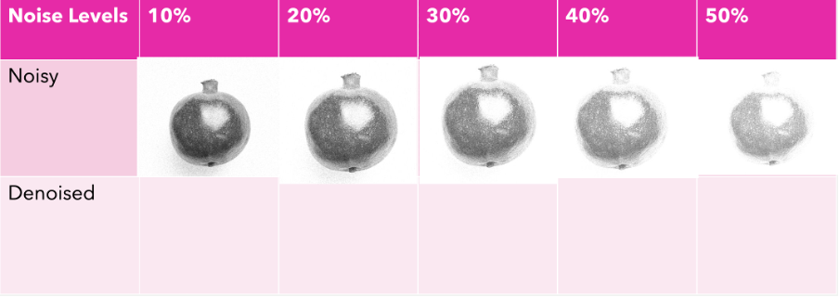
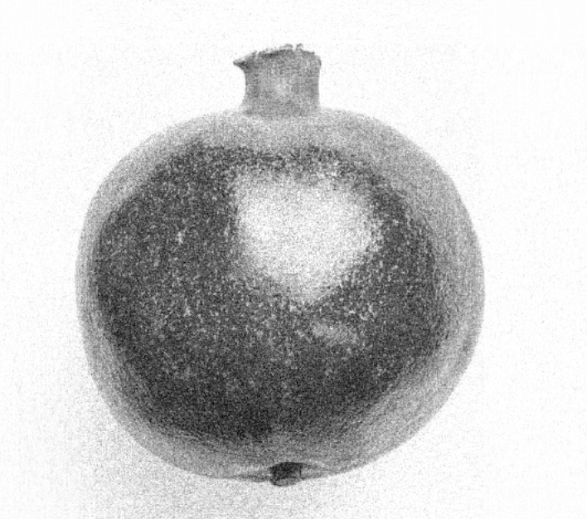
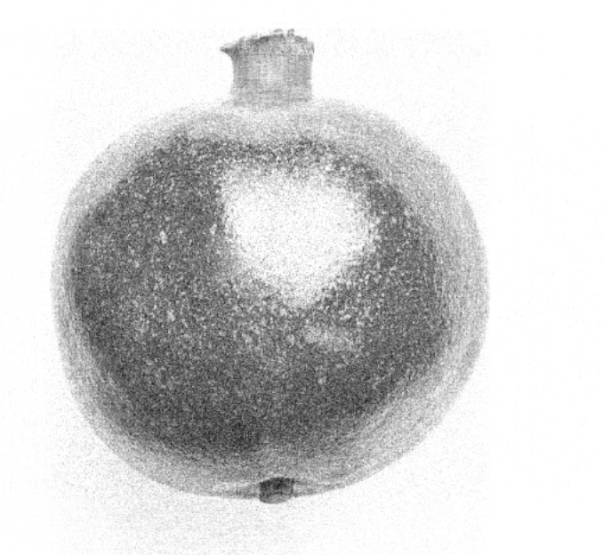
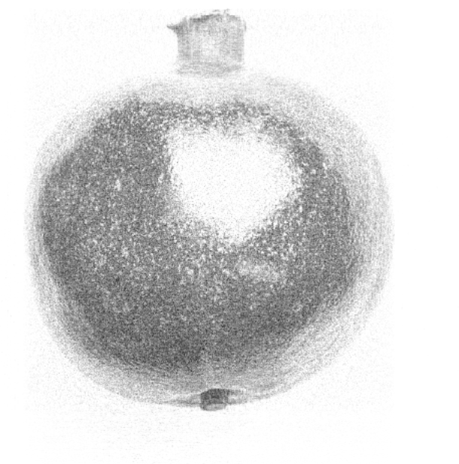
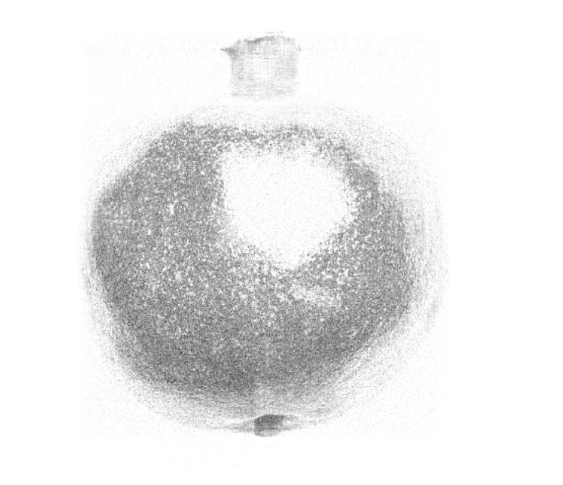
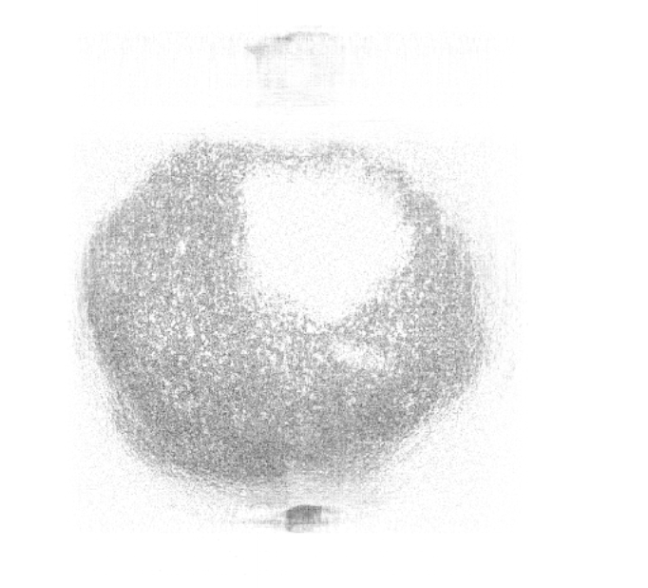
Gaussian Noise

Slide 9
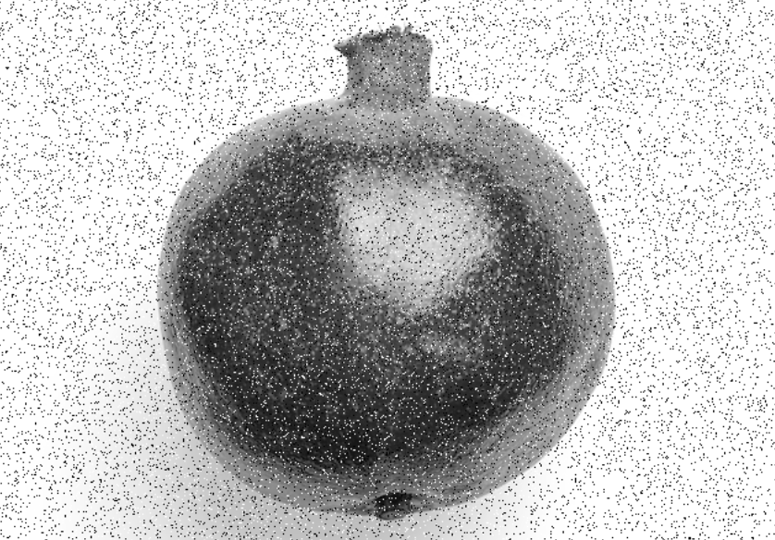
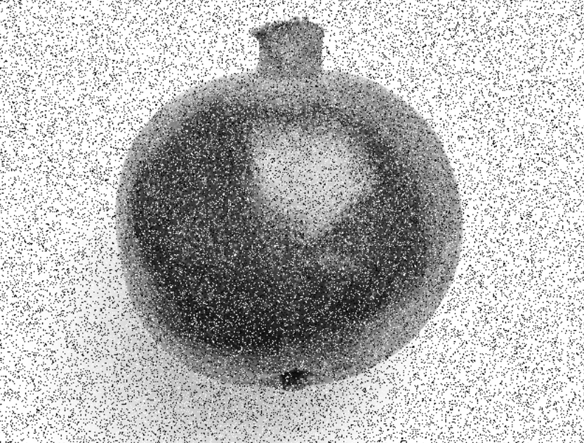
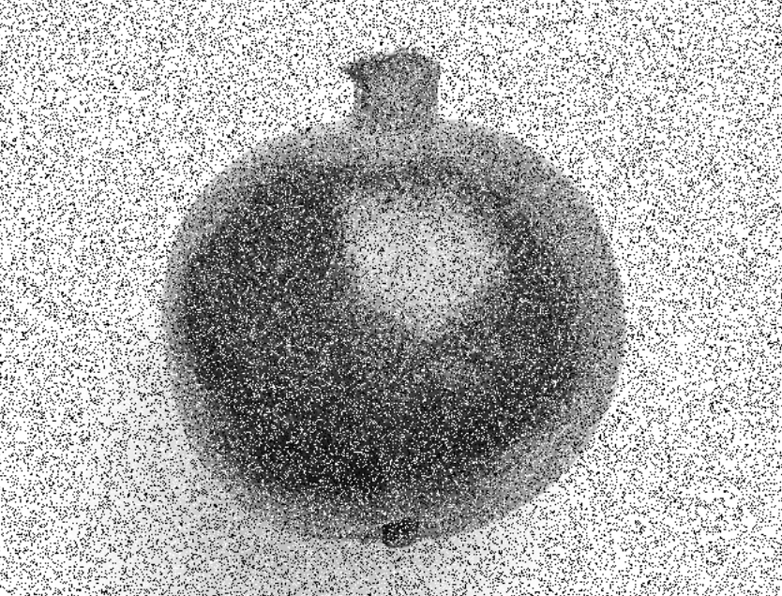
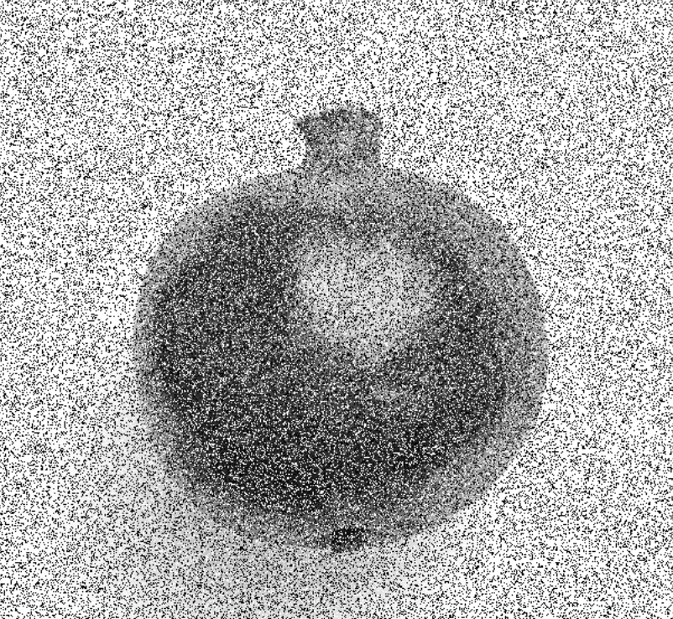
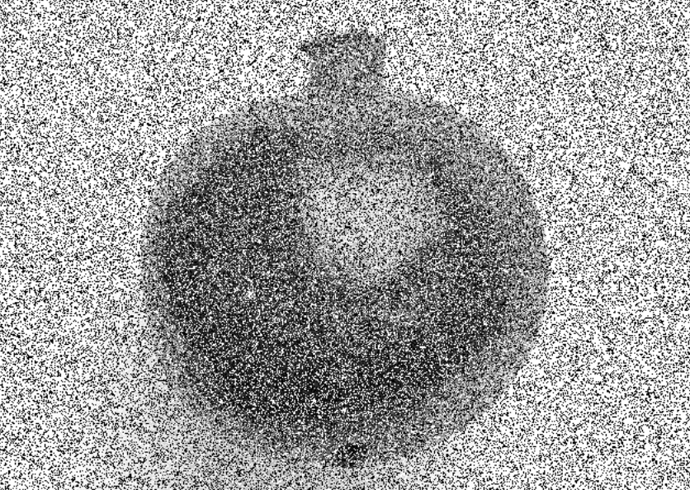
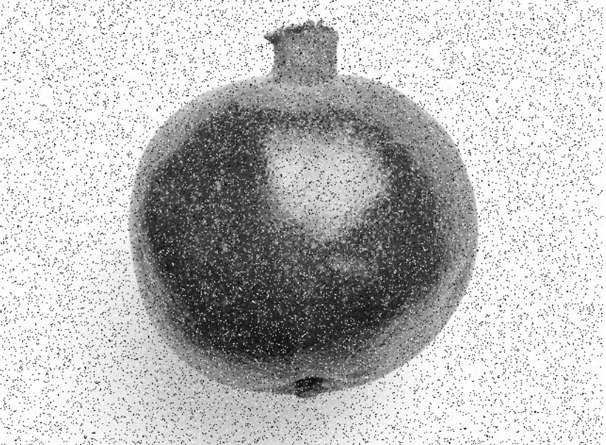
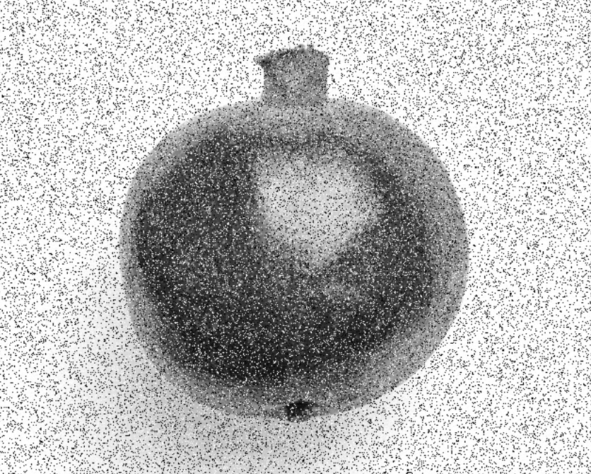
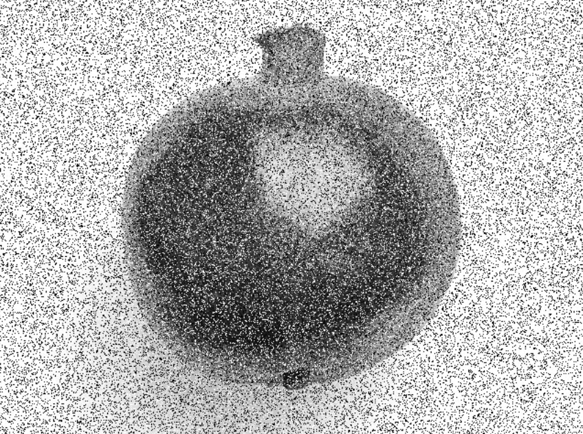
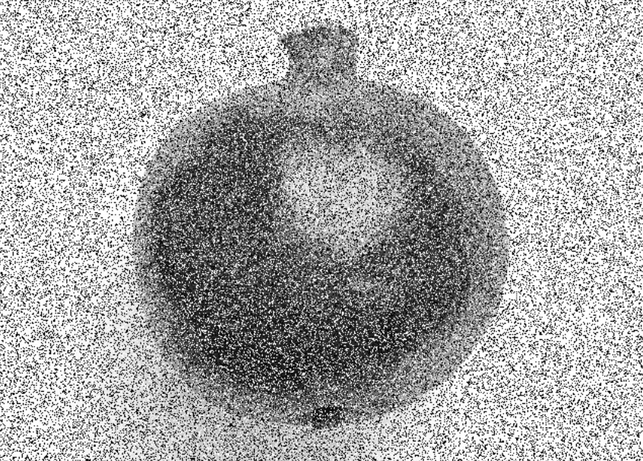
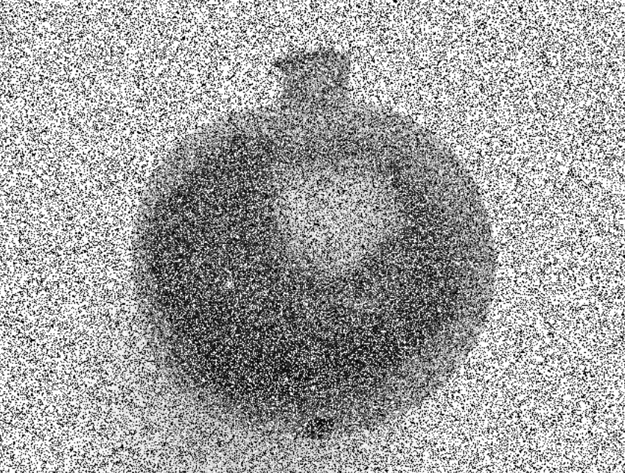
Salt And Pepper Noise
Noise Levels | 10% | 20% | 30% | 40% | 50%
Noisy
Denoised

Slide 10
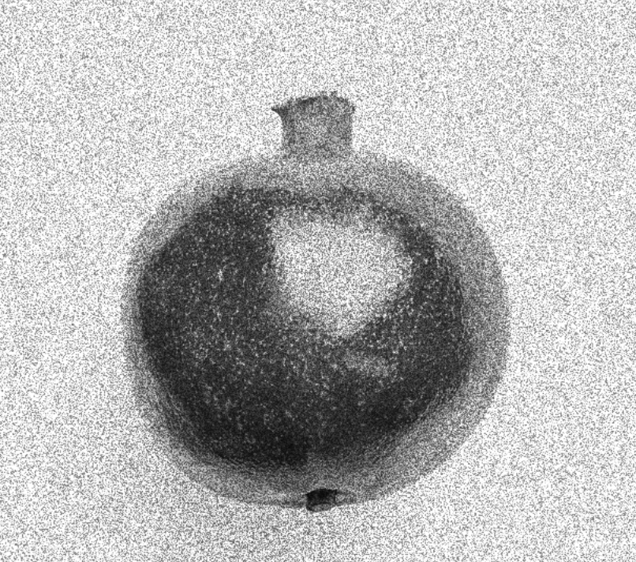
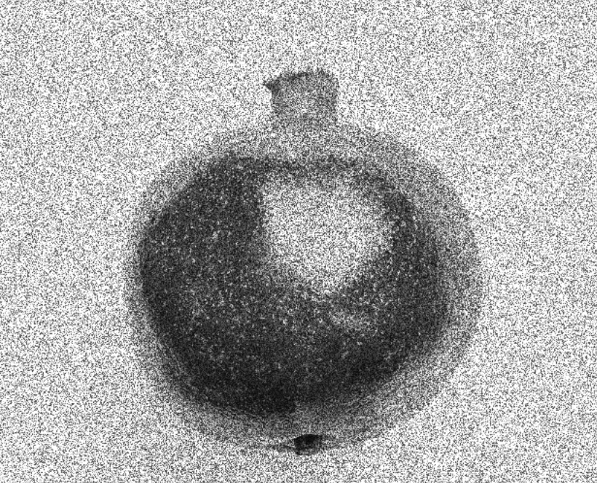
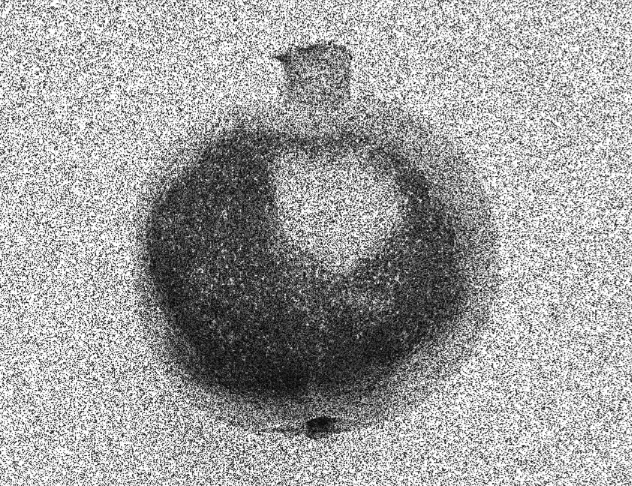
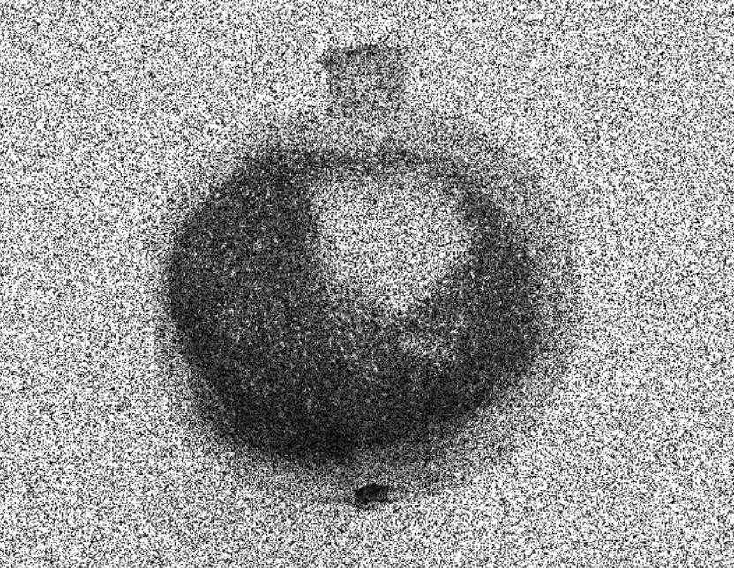
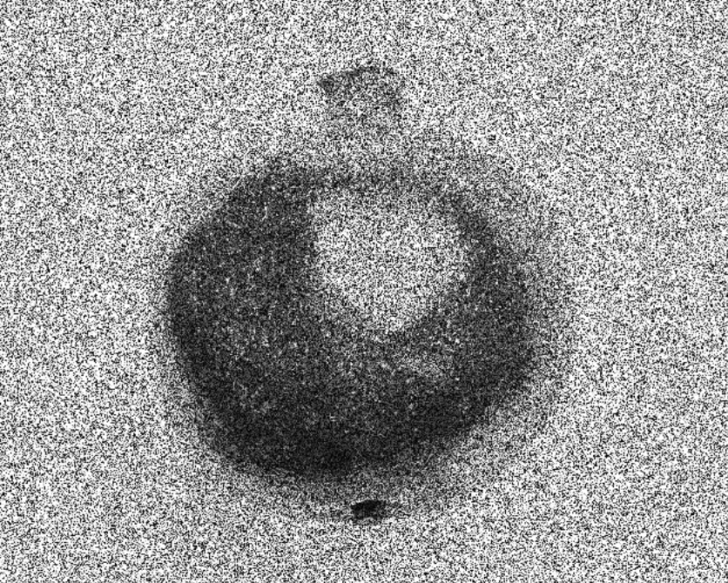
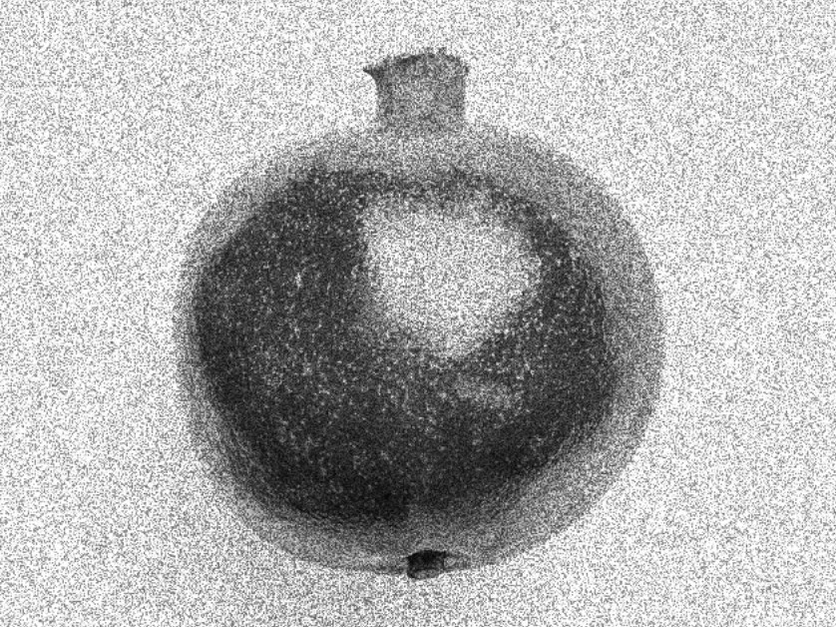
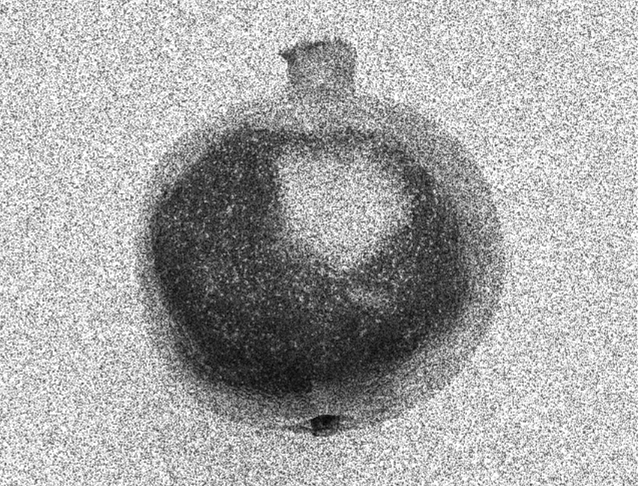
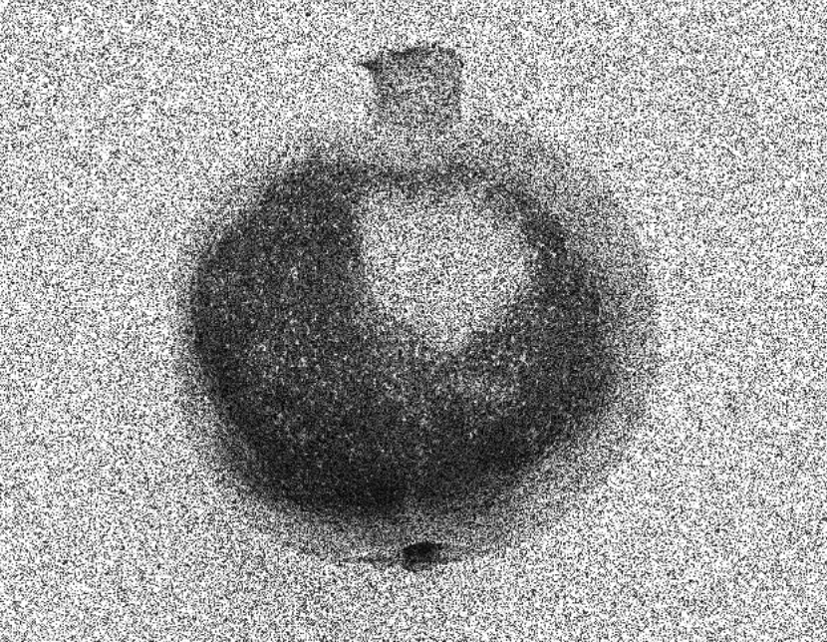
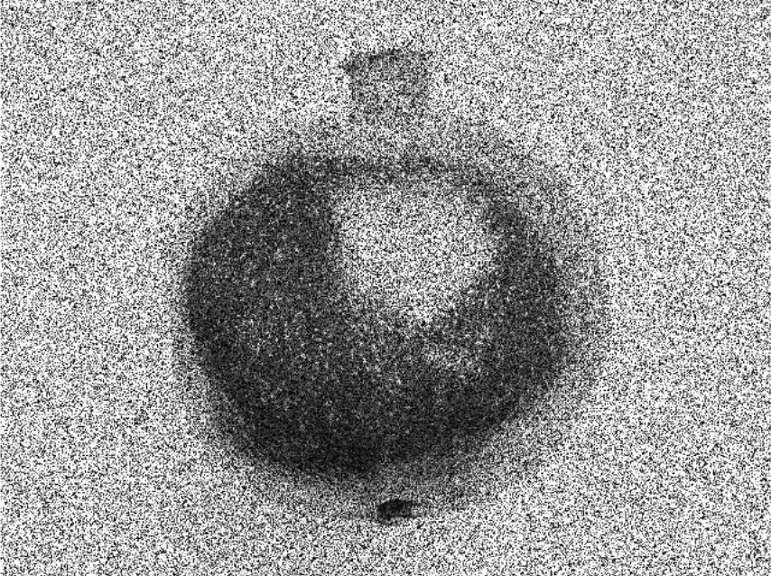
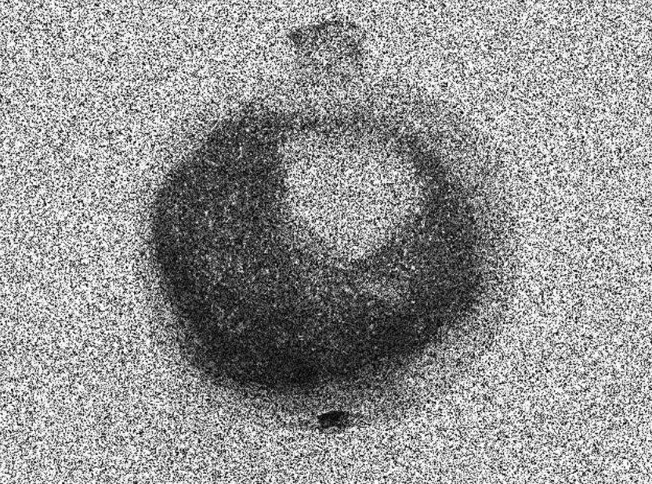
Speckle
Noise Levels | 10% | 20% | 30% | 40% | 50%
Noisy
Denoised

Slide 11
Principal Component Analysis (PCA) Denoising
PCA has wide application in statistical pattern recognition and signal processing
In PCA-based denoising, the original image is transformed into PCA domain and thereby preserves the important principal components only and removes the noise components

Slide 12
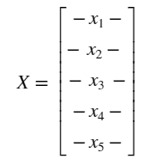
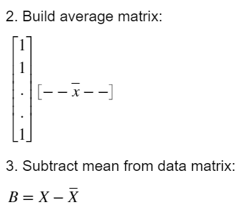
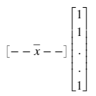
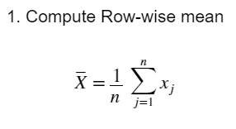
Given an image
n x m
n x m
n x 1

Slide 13
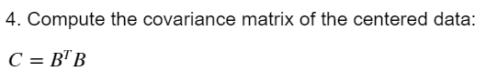
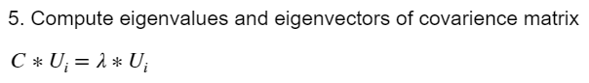
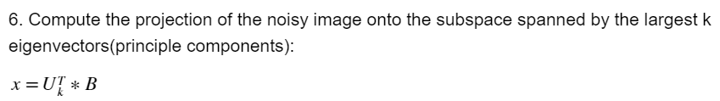
Based on eigenvalues and eigenvectors:
n x n
n x n
n x 1
K x n
N x k
K x m

Slide 14
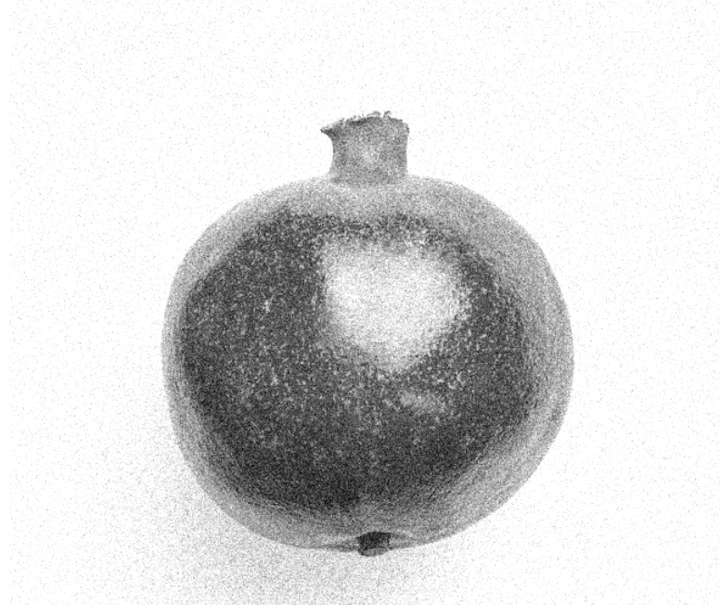
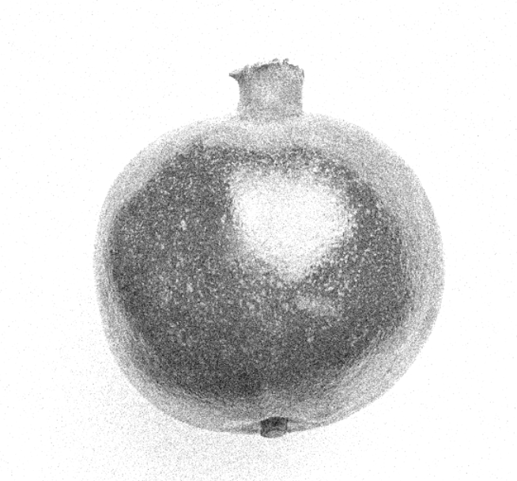
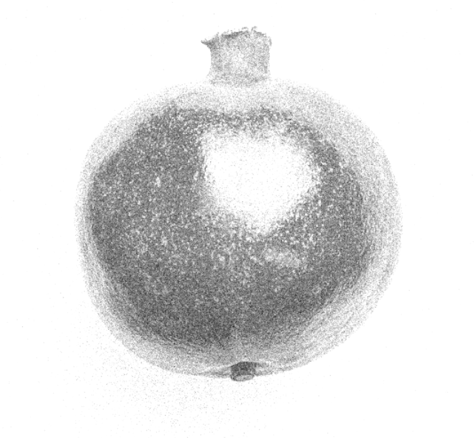
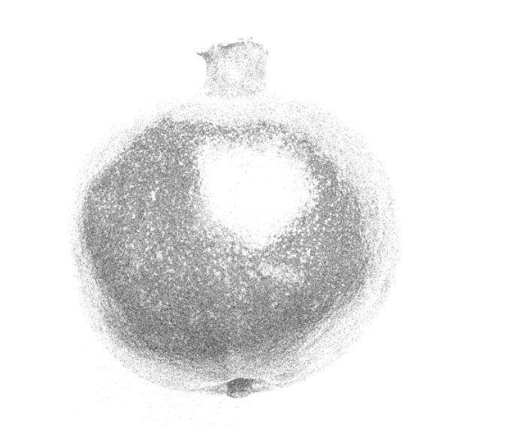
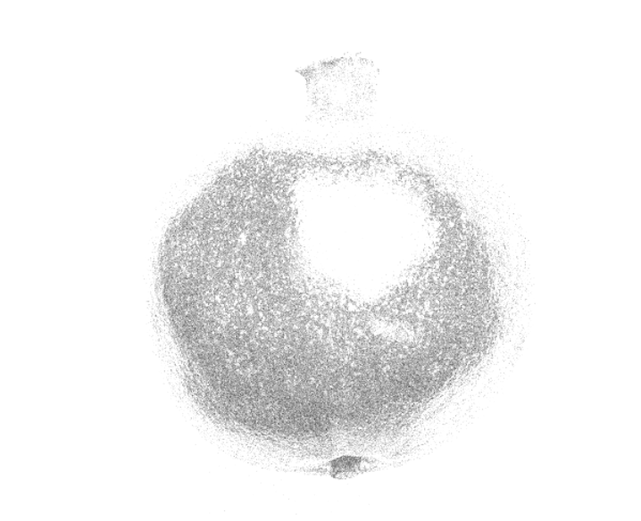
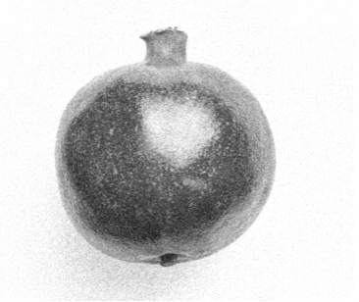
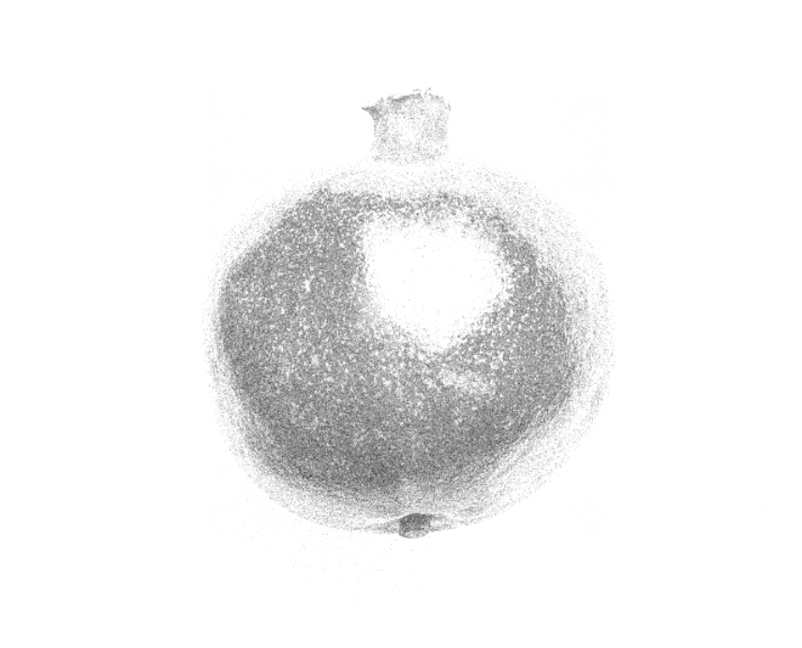
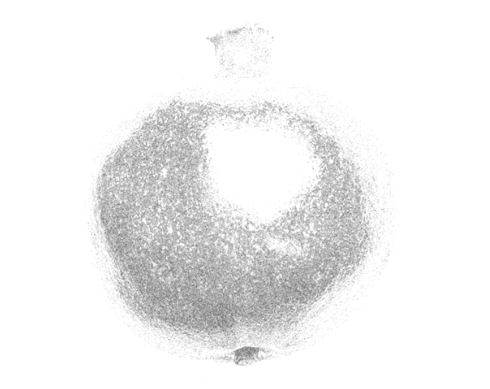
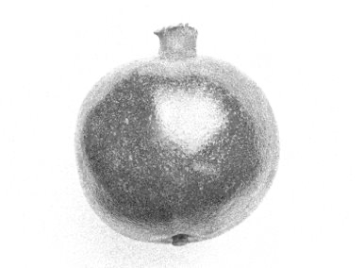
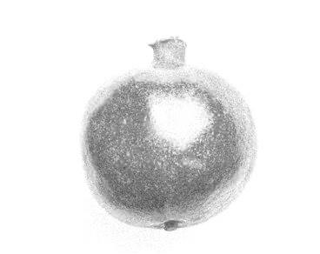
Original Image
Grey-scale Image
Gaussian Noise
Noise Levels | 10% | 20% | 30% | 40% | 50%
Noisy
Denoised
Notes:
pca

Slide 15
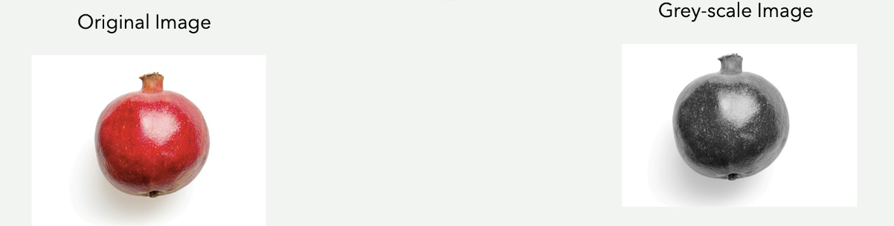
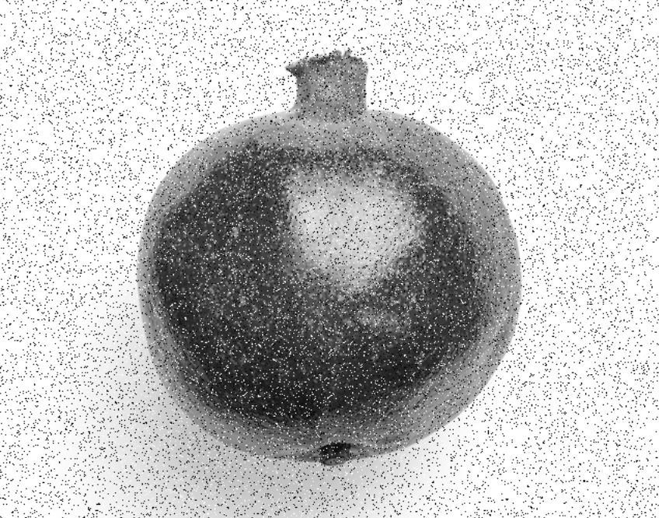
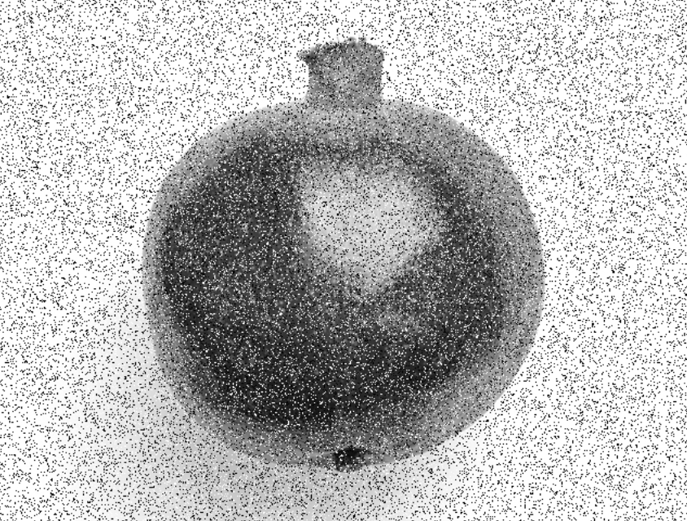
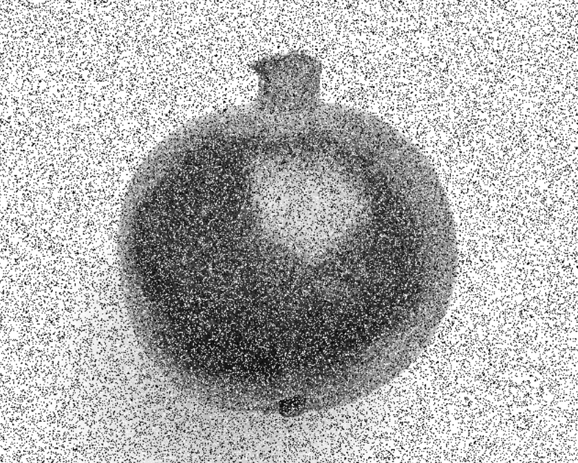


Salt And Pepper Noise
Noise Levels | 10% | 20% | 30% | 40% | 50%
Noisy
Denoised

Slide 16





Speckle
Noise Levels | 10% | 20% | 30% | 40% | 50%
Noisy
Denoised

Slide 17
Discrete Cosine Transform (DCT) Denoising
DCT (Discrete Cosine Transform) denoising is a technique used to remove noise from a signal by applying a DCT transform to the signal, thresholding the DCT coefficients, and then reconstructing the signal using the threshold coefficients.
The thresholding step is used to suppress coefficients that are likely to be due to noise, while preserving those that are likely to be part of the underlying signal.

Slide 18

Equation
The mathematical representation of DCT of an image is given by ,
where F(u,v) is the DCT coefficients of the image, f(x,y) is the original image, C(u) and C(v) are normalization constants, and M and N are the number of rows and columns in the image.

Slide 19

The inverse DCT (IDCT) is then applied to the threshold DCT coefficients to obtain the denoised image. The mathematical representation of IDFC is given by,

Slide 20






Original Image
Grey-scale Image
Gaussian Noise

Slide 21





Salt And Pepper Noise
Noise Levels | 10% | 20% | 30% | 40% | 50%
Noisy
Denoised

Slide 22





Speckle
Noise Levels | 10% | 20% | 30% | 40% | 50%
Noisy
Denoised

Slide 23
Wavelet transform
Wavelet based denosing repressents an image as linear combination of wavelet coefficients which preserves the important features of image. The main three process:
STEP 1: Transforming the image into a set of wavelet coefficients
– to represent image characetersitcs in different frequency bands
STEP 2 : Detect Noise and Remove them from wavelet coefficients using thresholding , -wavelet shrinkage and wavelet domain filtering
SETP 3: Apply inverse wavelet transform to the image
- reconstructed the image from the modified wavelet coefficients
RESULT : image with reduced noise
Notes:
Remove the noise

Slide 24
Wavelet based denoised scheme
Wavelet transform
Thresholding
Inverse
Wavelet
transform
Decompositon
Reconstruction
Notes:
first your signal f(k) is decomposed using the wavelet transform into the various wavelet
coefficients generally the approximation coefficients and detail coefficients
and these are coeffiecients are thresholded we get the thresholded taking the inverse transform to get the denoised image or signal f (k)

Slide 25

Notes:
The wavelet decomposition of an image is done as follows: In the firstlevel of decomposition, the image is split into 4 subbands,
namely the HH, HL, LH and LL sub bands. The HH sub band gives the diagonal details of the image; the HL sub band gives the horizontal features while the LH subband represents the vertical structures. The LL subband is the low resolution residual consisting of low frequency components and it is this subband which is further split at higher levels of decomposition.

Slide 26






Gaussian Noise

Slide 27





Salt And Pepper Noise
Noise Levels | 10% | 20% | 30% | 40% | 50%
Noisy
Denoised

Slide 28





Speckle
Noise Levels | 10% | 20% | 30% | 40% | 50%
Noisy
Denoised

Slide 29
Non-Negative Matrix Factorization (NMF) is a technique that can be used for image denoising by decomposing the image matrix into two non-negative matrices. One represents the basis of the image and the other represents coefficient. By decomposing the image matrix in this way, the noise can be separated from the useful information in the images.
Non-Negative Matrix Factorization

Slide 30


Mathematical equation
Given a non-negative matrix $A$ of size $m×n\text{,}$ NMF finds two non-negative matrices W of size $m×k$and H of size $k×n$ such that:
$$A≈W∗H$$
Where k is the rank of the approximation.
By minimizing the approximation error, NMF finds the two non-negative matrices W and H that best approximate the original matrix A.
k ≤ min(m,n)

Slide 31





Gaussian Noise

Slide 32





Salt And Pepper Noise
Noise Levels | 10% | 20% | 30% | 40% | 50%
Noisy
Denoised

Slide 33





Speckle
Noise Levels | 10% | 20% | 30% | 40% | 50%
Noisy
Denoised

Slide 34

Results

Slide 35
PSNR, SSIM - Pomegranate

Slide 36




Slide 37




Slide 38




Slide 39

PSNR, SSIM - Lena

Slide 40




Slide 41



Slide 42



